Slide 1

Analog & Digital Sound

Slide 2
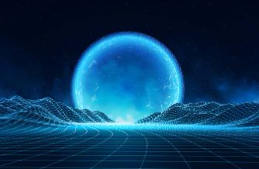
Analog to Digital Conversion
You live in an Analog world.
“Analog” means unlimited variations.
Examples:
Complete darkness to bright light
Very cold to very hot
Very low tones to very high tones
A prism of color

Slide 3
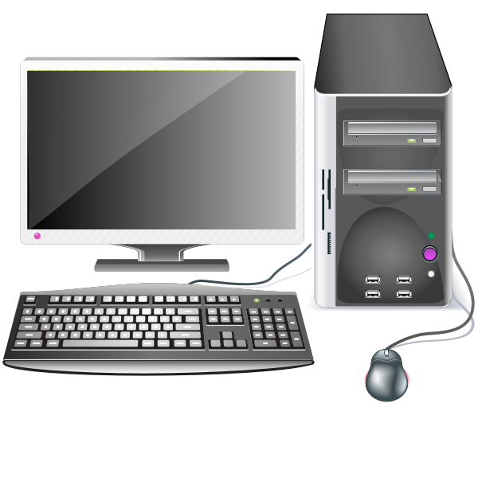
Analog to Digital Conversion
A computer is Digital.
“Digital” means variations in specific intervals.
A computer can’t handle unlimited variations.
Analog data must be converted to digital data.

Slide 4
Analog to Digital Conversion
Example - temperature
The real-world has an infinite number of temperatures, from very cold to very hot
A digital device has a specific number of temperatures, in specific intervals
Example - light
The real-world has an infinite measurement of light, from complete darkness to complete light
A digital device has a specific number of brightness variation, in specific intervals

Slide 5
Analog to Digital Conversion
Example -- sound
Sound is created by waves, which are analog and have infinite variation
A digital device must represent a sound wave in intervals
Fortunately the digital approximation is usually good enough.

Slide 6
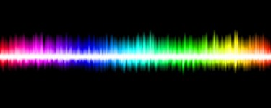
What is Analog?
Smooth and continuous signals that represent a quantity, like sound waves

Slide 7
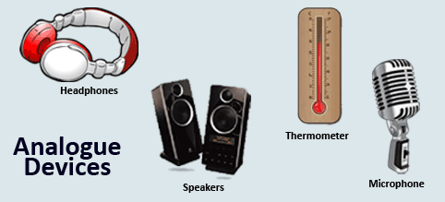
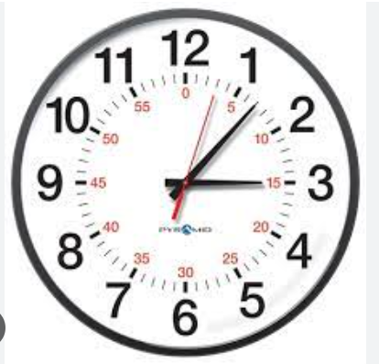
Analog devices:

Slide 8
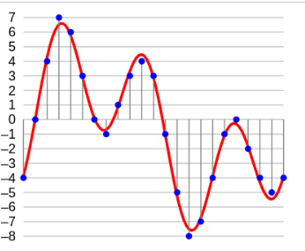
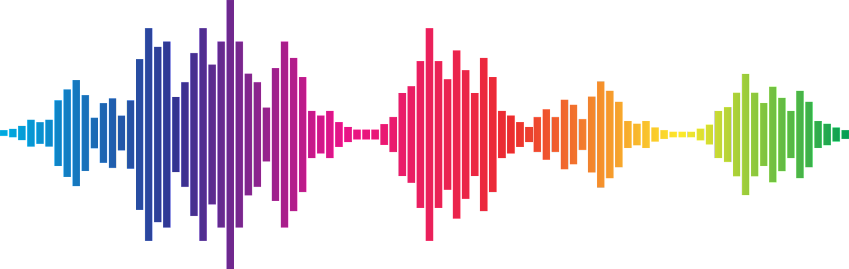
What is Digital?
A numerical representation of an analog signal, represented in increments

Slide 9
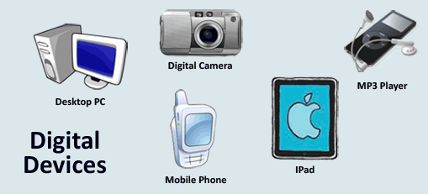
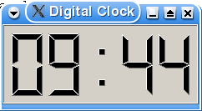
Digital devices:

Slide 10
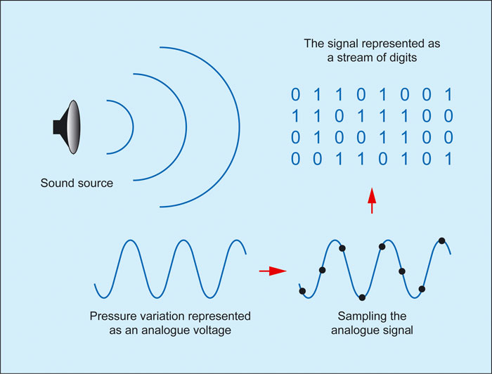
Changing Analog to Digital:
Source: https://www.soundonsound.com/techniques/digital-myth

Slide 11
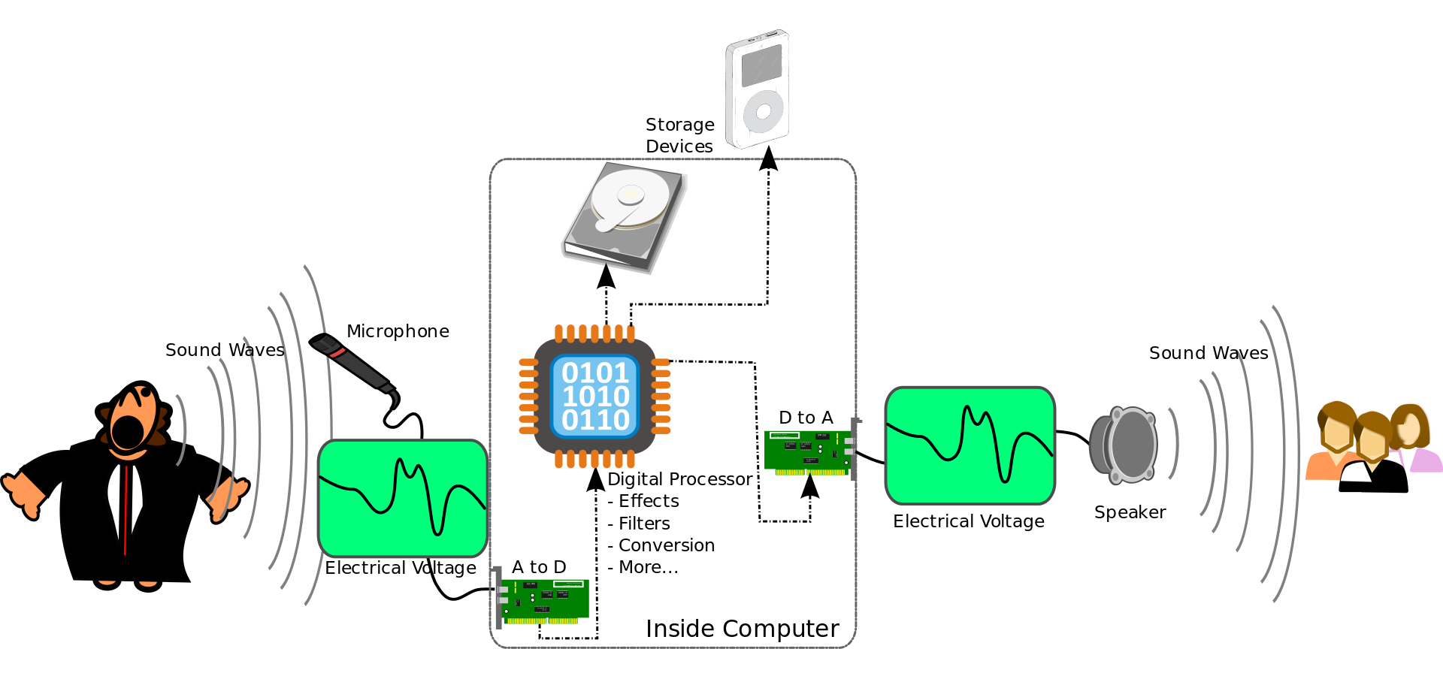
The lifecycle of sound
An ADC (Analog to Digital Converter) is used to change analog to digital so the sound can be processed by the computer.
An DAC (Digital to Analog Converter) is used to change digital to analog so you can hear the sounds.
Attribution: File:A-D-A Flow.svg, From Wikimedia Commons, the free media repository

